Slide 1
Firewalls and network security
To know of threats and controls in wired networks.
How various firewalls works, filtering routers, application firewalls and IDS, IPS & WAF
Tue Becher

Slide 2

Security update
http://watchguardsecuritycenter.com

Slide 3
Network Security?
Any activities designed to protect your network
Activities that protects
usability
reliability
confidentiality
integrity
and safety of your network and data.
Should target a variety of threats - and stop them from entering or spreading on your network.

Slide 4
Threats
Viruses, worms, and Trojan horses
Spyware and adware
Zero-day attacks, also called zero-hour attacks
Hacker attacks
Denial of service attacks
Data interception and theft
Identity theft
…

Slide 5
No single solution
need multiple layers of security - if one fails, others still stand.
Utilize hardware and software components
Remember to update!!!
Often includes:
Anti-virus and anti-spyware
Firewall, to block unauthorized access to your network
Intrusion prevention systems (IPS), to identify fast-spreading threats, such as zero-day or zero-hour attacks
Virtual Private Networks (VPNs), to provide secure remote access

Slide 6
Communicating data
Network packets
Contains info required to route it to the destination
Contains info to deliver it to the correct application on the destination system.

Slide 7
Firewalls
Protecting your computer from the big bad internet…
Hardware or software based
Checkpoint for communication on a network
Blocks unauthorized access
91.182.13.174
Router
192.168.*.*

Slide 8
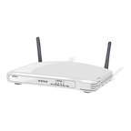
All-in-one for home use
Firewall, router, switch and wireless access point
91.182.13.174
192.168.*.*

Slide 9
Firewall – the basic technologies
Packet Filtering
Circuit level gateways
Application level gateways
Statefull Inspection
Exercise:
Form groups – one technology for each group
Prepare a presentation of your subject – 20 minutes

Slide 10
Packet filtering
Examine data packets as they attempt to pass through the firewall
Rule based filtering using source, destination and port information within the packet
Easy to block traffic on specific ports
Simple but less secure

Slide 11
Circuit level gateways
Monitors TCP handshaking in the OSI session layer
Only allow traffic on valid connections (TCP)
Does not filter packages
Hides origin of internal traffic (similar to a proxy)
Example:
NAT – Network address translation

Slide 12
Application level gateways
Running proxy applications
HTTP, FTP, SMTP, POP3,...
No direct communication between outside sources and computers behind the firewall
Filtering rules can use the content of the data transmitted
No access to *.youtube.com

Slide 13
Statefull inspection
Combining packet filtering with gateway methods
Not running proxies, but maintaining a request table
Packet filtering firewall that examine packet content to match against

Slide 14
Using more than 1 firewall
Why???

Slide 15
Using more than 1 firewall
Why???
Internal:
Should the developers have access to accounting information
External:
Breach of one server should not automatically mean breach of other servers..

Slide 16
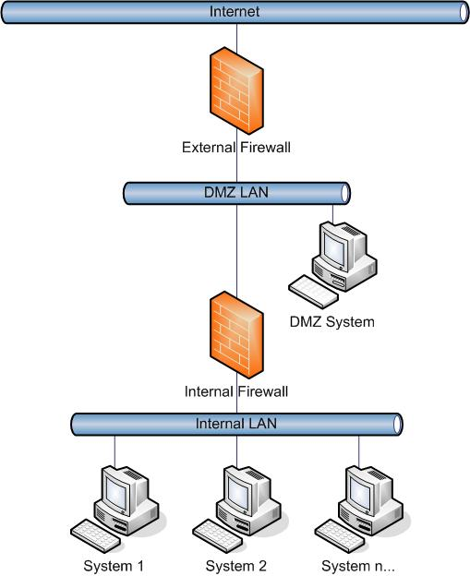
DMZ

Slide 17
Network Intrusion
Unauthorized access to the network
Virus, Worms and Trojans replicating on the network
Specially crafted network packages sent to exploit a vulnerability
Attacks to render services unresponsive

Slide 18
Intrusion Detection System
Software or hardware based traffic analysis
Monitor, analyse and respond to network events in real time
Look for signs of security policy violation incidents
Performs protocol analysis and content searching
Detects a variety of attacks and probe attempts
buffer overflows, port scans, OS fingerprinting etc.

Slide 19
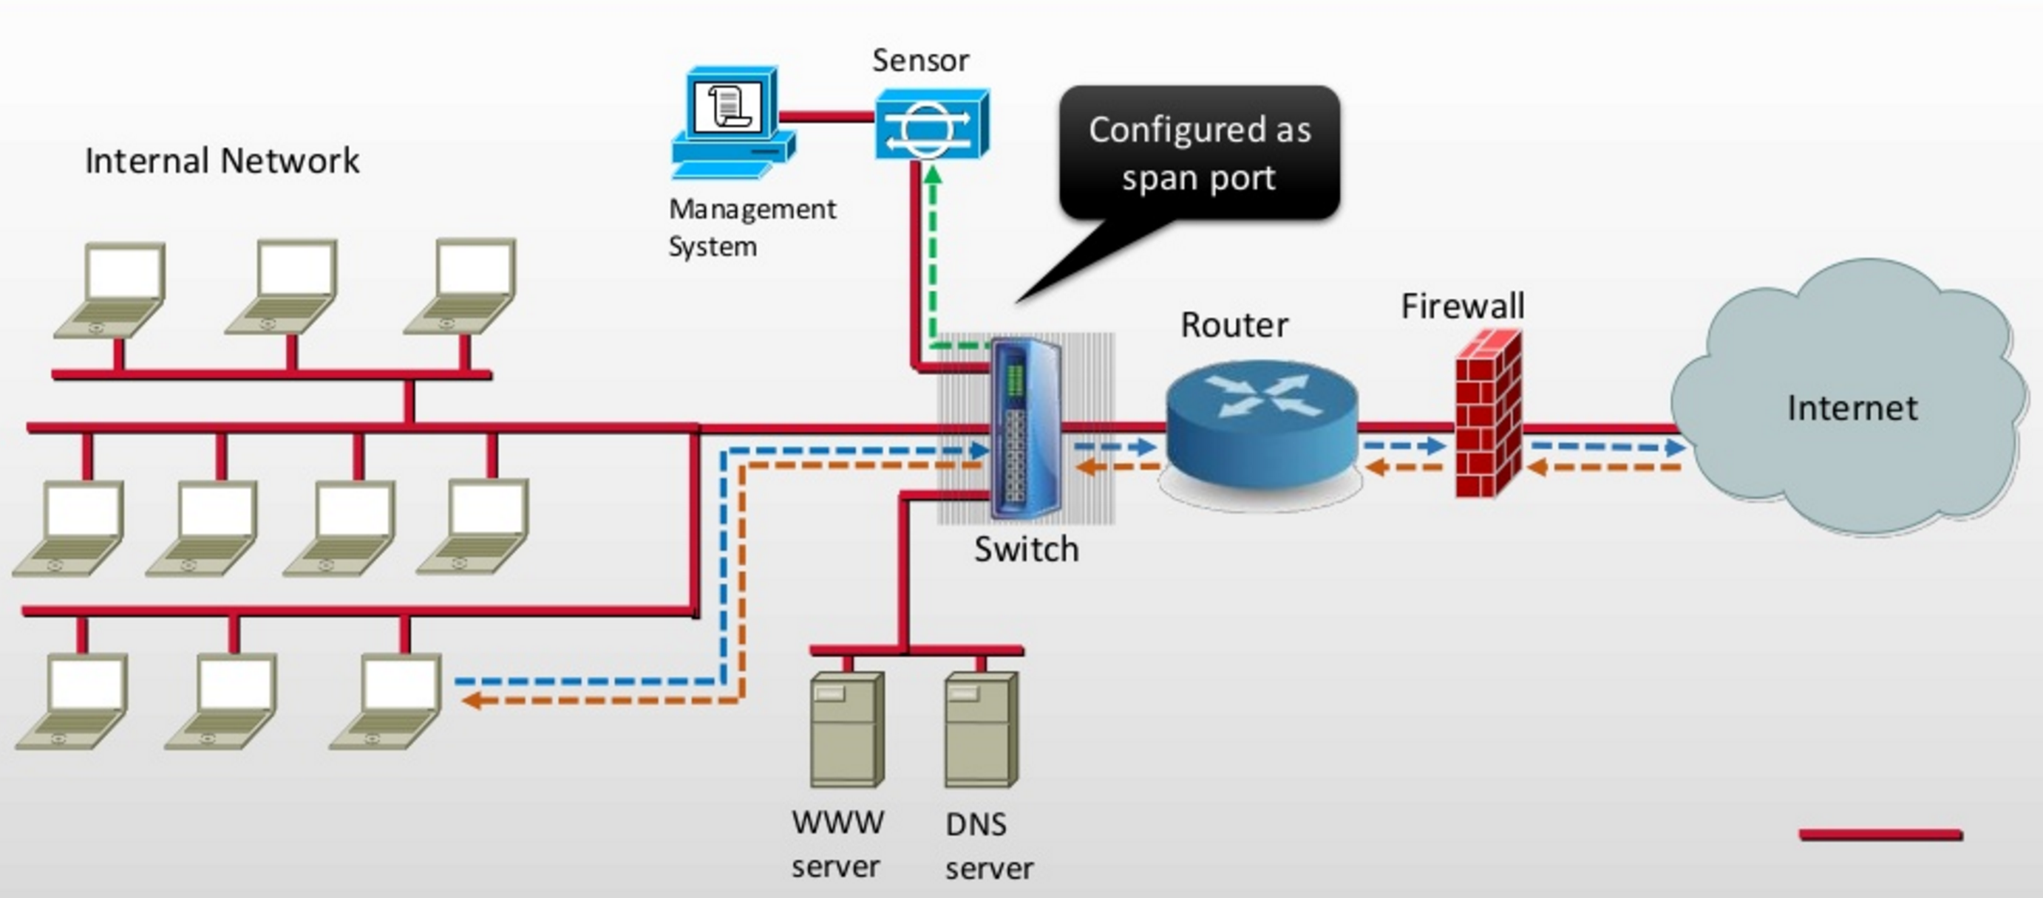
Passive IDS
http://www.slideshare.net/nikhilraj149/intrusion-detection-and-prevention-system

Slide 20
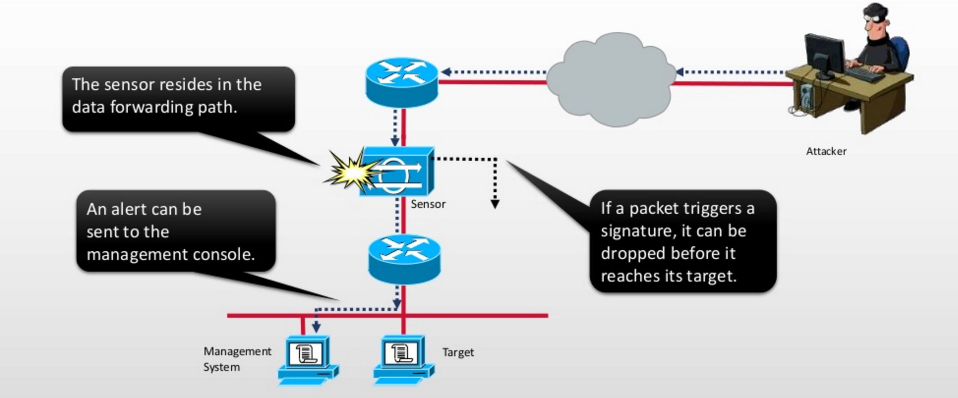
Inline IPS
http://www.slideshare.net/nikhilraj149/intrusion-detection-and-prevention-system

Slide 21

Snort a free IDS/IPS
www.snort.org
Real-time traffic analysis and packet logging
Open source
Free community rules
Paid registered/subscription rules
Three modes:
Sniffer mode – sniff network traffic
Packet Logger mode – store all data packets in a file
IDS/IPS mode – compare to signatures and report if match is found
Snort detects:
CGI attacks, Buffer overflows, SMB probes, OS fingerprinting, Port Scans, ...

Slide 22
CGI attacks
Common Gateway Interface (CGI)
protocol for interfacing a server side script.
Often used to process data from fill-in forms
Threat example:
Exploit flaws in CGI scripts on a web server
HTTP servers often has a demo directory
Known to contain scripts with vulnerabilities that allow anyone to execute commands on your server.
phf – updates a phonebook style listing of people
http://example.com/cgi-bin/phf?Qalias=x%0a/bin/cat%20/etc/passwd

Slide 23
Buffer overflows
Data is stored in a buffer outside the memory set aside for the data.
Extra data overwrites adjacent memory.
Change of program variables or flow.
Threat example:
Savant Web Server 3.1 Remote Buffer Overflow Exploit
Send overflow data using a GET request – results in error but leaves server in a vulnerable state
Allows attacker to open access to the server via another port.

Slide 24
SMB Probes
Server Message Block probe checks a system to determine what shared files are available.
Can be used to look for file system weaknesses.

Slide 25
OS fingerprinting
Sending requests trying to detect server OS
If found, attacker can focus on know vulnerabilities.
Easy to do using tools like nmap (add –O option)
# nmap -O -v scanme.nmap.org
Starting Nmap ( http://nmap.org )
.....
Running: Linux 2.6.X
OS details: Linux 2.6.20-1 (Fedora Core 5)
Uptime guess: 11.433 days (since Thu Sep 18 13:13:01 2008)

Slide 26
Port scans
Checking a server for open ports
Its like ringing the doorbell to see if someone will answer the door.
Check all or only commonly used ports
Used to learn more of the target system
Focus on known attacks

Slide 27
WAF

Slide 28
Web Application Firewalls
WAF – aka:
Deep packet inspection firewall
Web Application Shields
Web Application Security Filters
Apply a set of rules to an HTTP conversation
Many current WAF products detect both inbound and outbound attacks

Slide 29
WAF – operations modes
Negative model (blacklisting)
Maintain a DB of known attack signatures
Ex.: Disallow any user input which contain ”<script>”
Positive model (whitelisting)
Build policies based on valid known requests.
Application specific parameter guarding
Ex.: Page foo.jsp, field ”id” accept numbers [0-9] in the range 0 to 65535
Mixed

Slide 30
WAF – main benefits
Basic protection against know attacks using blacklists
PCI DSS – the credit card industry prescribes using WAF
Allows hot fixing uncovered application vulnerabilities
Safe during the time needed to change application and wait for a deployment window (could be weeks)
Source code analysis tools can recommend rule sets
May be the only way to secure a 3. part application

Slide 31
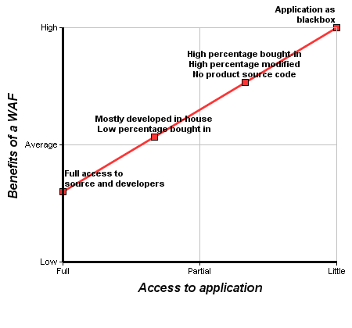
WAF – benefits
http://www.owasp.org/index.php/File:Best_Practice_WAF-chart-EN.png

Slide 32
WAF – weaknesses
Bad rules, design or implementation
Makes the overall system more complex
WAFs may also have/generate errors
May make troubleshooting more difficult
Training and testing the WAF can be expensive
Tools exists:
WAFW00F – identify WAF systems
WAFFUN – search for WAF system weaknesses

Slide 33
Student presentations
Example of topics:
Personal firewalls
Planning zones in a network
Using Snort
Kali linux

Slide 34
Till next time
Info / literature / links on Fronter – keep updated!!!
Reading:
http://en.wikipedia.org/wiki/Onion_routing
http://en.wikipedia.org/wiki/Tor_(anonymity_network)
Additional reading: https://www.torproject.org
https://en.wikipedia.org/wiki/Virtual_private_network
http://en.wikipedia.org/wiki/Nessus_(software)
Additional reading: http://www.tenable.com/products/nessus
http://www.coresecurity.com/penetration-testing-overview
NISTSpecial Publication 800-153 (on Fronter):
Guidelines for Securing Wireless Local Area Networks (WLANs)
Digital Inspiration – How to Secure Your Wireless (Wi-Fi) Home Network
http://www.labnol.org/internet/secure-your-wireless-wifi-network/10549/
Find and comment on interesting news relevant for the weeks subjects
Help your classmates - share your findings via Fronter.
Create a link or upload files in: WEBSTUD > Resources > Security > 2016 Spring > Share

